Slide 1
Limitation of RSA Wiener’s attack
Presented by Bowen Dai, Chengcheng Li, Ziyi Zhao

Slide 2

RSA brief review
Public key: (m, k)
Private key: (d, p, q)
p & q are distinct prime numbers, m = p * q and kd $≡$ 1 mod $φ$(m)
Factorization is hard.
However, if we know private exponent d, we do not need to find the factor of m.

Slide 3

Wiener’s Theorem
Let $m=p ∗q$with q < p < 2q.
Let $d<\frac{1}{3}m^{\frac{1}{4}}$ .
Given (m, k) with k * d $≡$ 1 mod $φ$(m), an attacker can efficiently find d.

Slide 4



Proof
Based on approximations using continued fractions
Only needs a linear-time algorithm for recovering the secret key d
$\left|\frac{k}{φ\text{(}\text{m}\text{)}}−\frac{c}{d}\right|=\frac{1}{d\text{ ∗}φ\text{(}\text{m}\text{)}}$ where k * d - c * $φ$(m) = 1
By approximating m and replace $φ$(m), $\left|\frac{k}{\text{m}}−\frac{c}{d}\right|≤\frac{3c}{d \sqrt{m}}$
$$\left|\frac{k}{\text{m}}−\frac{c}{d}\right| ≤\frac{1}{d ∗m^{\frac{1}{4}}}<\frac{1}{2d^{2}}$$
$\frac{c}{d}$: convergent of the continued fraction expansion of $\frac{k}{\text{m}}$

Slide 5

Some important observations
When m is large:
$φ$(m) = (p-1)(q-1) = pq – (p+q) + 1 $≈$ m
From kd = 1 (mod $φ$(m)):
There exists an integer k such that
kd - c $φ$(m) = 1
$\frac{k}{φ\left(m\right)}−\frac{c}{d}=\frac{1}{dφ\left(m\right)}$ Since N is very large, $φ$(m) is also very large
$\frac{k}{m}≈\frac{c}{d}$

Slide 6


Finding $\frac{k}{m}$
Use continued fractions to find a set of convergent$\frac{c}{d}$ that approximate $\frac{k}{m}$
Convergent: approximation of a number using continued fraction
To find the convergent, we should first write the fraction as a continued fraction

Slide 7

Some remarks about the convergent
Since kd $≡$ 1 mod $φ$(m) and $φ$(m) is the product of two even numbers, $φ$(m) is even and both k and d are odd
If we find a convergent with even d, this convergent is not the one we look for
Since $φ$(m) is an integer, and kd - c $φ$(m) = 1
We rearrange the equation and get $φ$(m) $=\frac{kd−1}{c}$ which should also be an integer

Slide 8


More remarks about the convergent
$φ$(m)= (p-1)(q-1)
= pq –(p+q) +1
= m – (p+q) + 1
Rearrange:
p+q = m - $φ$(m) + 1
Consider the quadratic:
(x-p)(x-q) = 0
$x^{2}$ - (p+q)x + pq = 0
$x^{2}$-(m- $φ$(m)+1)x + m = 0
If the value of $φ$(m) is correct, the root of this equation is integers

Slide 9
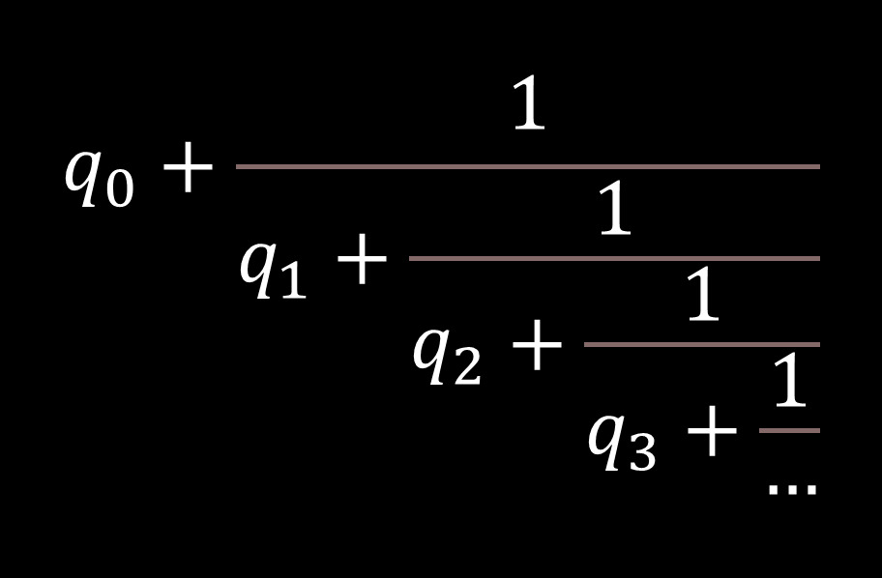

Continued Fractions
$$q_{0}+\frac{1}{q_{1}+\frac{1}{q_{2}+\frac{1}{q_{3}+\frac{1}{…}}}}$$
Usually denoted as <$q_{0}, q_{1}, q_{2}, q_{3}, …, q_{n}$>
Finite for any rational number, cyclic for any quadratic irrational number
quadratic irrational numbers: solutions of quadratic equation with irreducible square root
i.e. : $\frac{a+b\sqrt{c}}{d}$
where a, b, c, d are integers, d$≠0 and c$ is square free

Slide 10
Write any fraction as a continued fraction
Using Euclidean Algorithm with the numerator as the bigger number and the denominator as the smaller number regardless the real value of the numerator and denominator
Write the quotient in each equation as the q in the continued fraction

Slide 11


Example and proof
Reduce $−\frac{551}{802}$ to continued fraction
-551 = -1 * 802 + 251
802 = 3 * 251 + 49
251 = 5 * 49 + 6
49 = 8 * 6 + 1
6 = 6 * 1 + 0
$−\frac{551}{802}$ = -1 + $\frac{251}{802}$
$=−1+ \frac{1}{\frac{802}{251}}$
= $−1+ \frac{1}{3+\frac{1}{\frac{251}{49}}}$
.
.
.
$=−1+ \frac{1}{3 + \frac{1}{5+\frac{1}{8+ \frac{1}{6}}}}$

Slide 12


Find the convergent of a fraction using continued fraction
$$n_{0}=q_{0}$$
$$n_{1}=q_{0}q_{1}+1$$
$$n_{i}= q_{i}n_{i−1}+n_{i−2}$$
$$d_{0}=1$$
$$d_{1}=q_{1}$$
$$d_{i}=q_{i}d_{i−1}+d_{i−2}$$

Slide 13
Example
In an RSA encryption system, m = 64741 and the public exponent e = 42667. Find the decryption exponent d
First find some quotients we will use to calculate the convergent
42667 = 0 * 64741 + 42667
64741 = 1 * 42667 + 22074
42667 = 1 * 22074 + 20593
22074 = 1 * 20593 + 1481
:

Slide 14

Now we get the first few values of $q_{i}$: <0, 1, 1, 1, …>
Then calculate the convergent
First convergent: $\frac{n_{0}}{d_{0}}$ = $\frac{0}{1}$ -> d = 1 obviously not the d we need
Second convergent: $\frac{n_{1}}{d_{1}}=\frac{q_{0}q_{1}+1 }{q_{1}}=$ $\frac{1}{1}$ -> d = 1
Third convergent: $\frac{n_{2}}{d_{2}}=\frac{q_{2}n_{1}+n_{0}}{q_{2}d_{1}+d_{0}}=$ $\frac{1}{2}$-> d = 2, impossible because d must be odd
Forth convergent: $\frac{n_{3}}{d_{3}}= \frac{q_{3}n_{2}+n_{1}}{q_{3}d_{2}+d_{1}}=$ $\frac{2}{3}$-> d = 3 possible d
Now we check other properties of d

Slide 15

$φ$(m) = $\frac{kd−1}{c}$ = $=\frac{42667∗3−1}{2}$ = 64000 <- an even integer
d = 3 passes the second check. Pass on the next check
If the value is correct, both roots of the following quadratic should be integers:
$x^{2}−\left(m − φ\left(m\right)+1\right)x+m$ = $x^{2}−742x+64741$
Use quadratic formula to find the roots:
$x=\frac{−b±\sqrt{b^{2}−4ac}}{2a}$ = $\frac{742±\sqrt{{\left(−742\right)}^{2}−4∗1∗64741}}{2∗1}$
We get x = 641 or x = 101

Slide 16
Practices to prevent Wiener’s Attack

Slide 17

Large k
Recall:
Public key: (m, k)
m = p * q
A random number relative prime to $φ$(m)
k’ = k + t * $φ$(m) ( t is some large number)
k’ > $m^{1.5}$, the proof based on approximation does not work
Pitfall: increase encryption time

Slide 18
Chinese remainder theorem
Powerful tool for enhancing RSA decryption efficiency by breaking down the computation into smaller, more manageable tasks.
When decrypting a ciphertext, instead of performing modular exponentiation modulo k, CRT allows us to perform modular exponentiation modulo the prime factors of k separately.
Apply to speed up the decryption process in RSA
Reduce the computational complexity of decryption.

Slide 19
Chinese remainder theorem
Let m and n be relatively prime positive integers. For all integers a and b, the pair of congruences
x ≡ a (mod p) x ≡ b (mod q)
has a solution, and this solution is uniquely determined modulo (pq).
X ≡ m (pq)
What is important here is that q and q are relatively prime. There are no constraints at all on a and b.

Slide 20
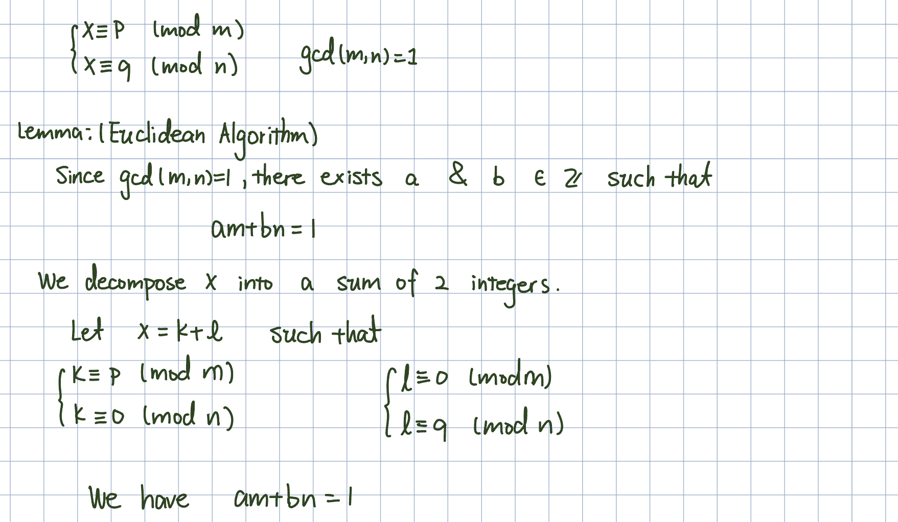
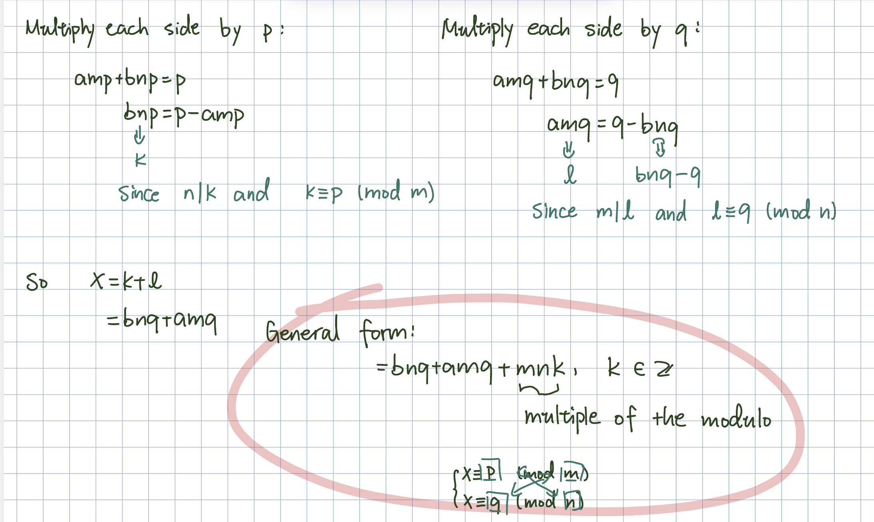
General Formula to Apply:
Notes:
Let’s derive the general formula for Chinese Remainder theorem.
Suppose X equals p modulo m and q modulo n. Them we break X into a sum of 2 integers such that X= k+l. We let K take care of p and l take care of n.

Slide 21
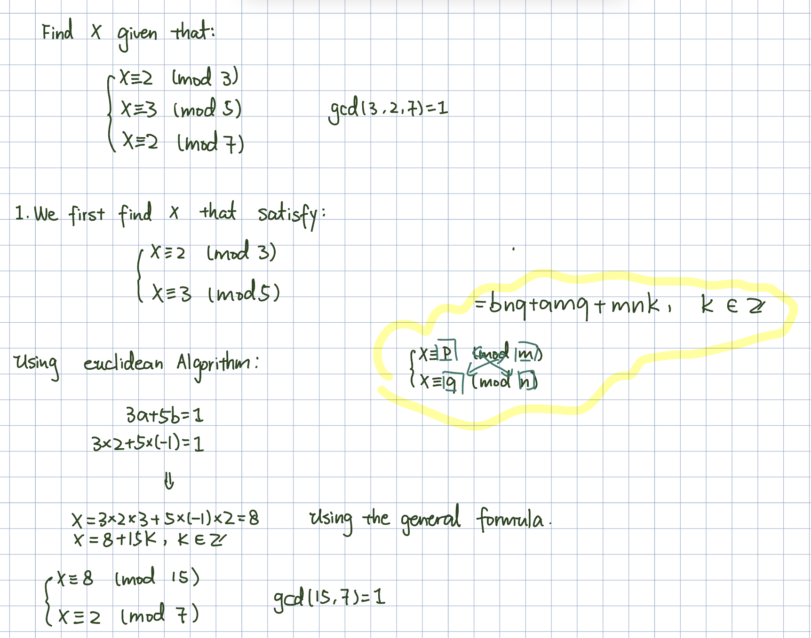
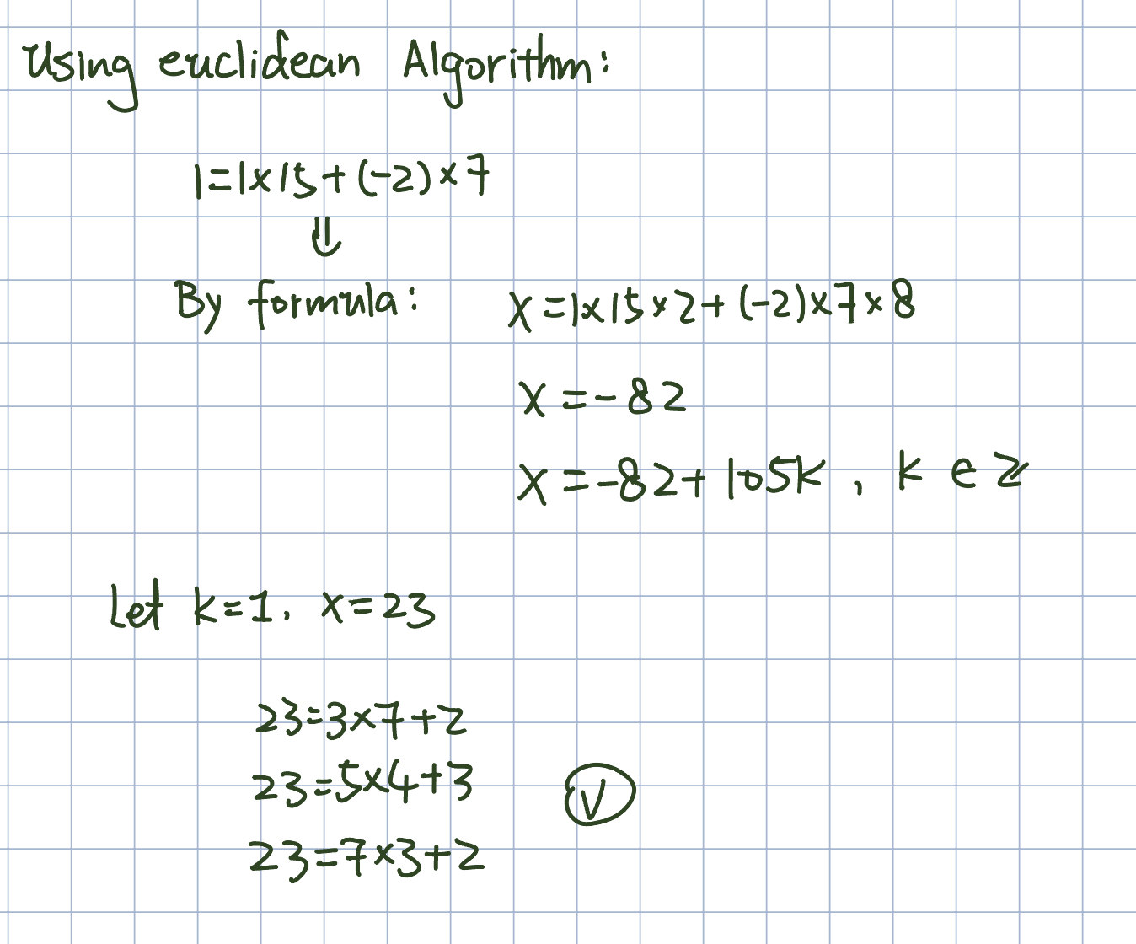
Example of Usage

Slide 22
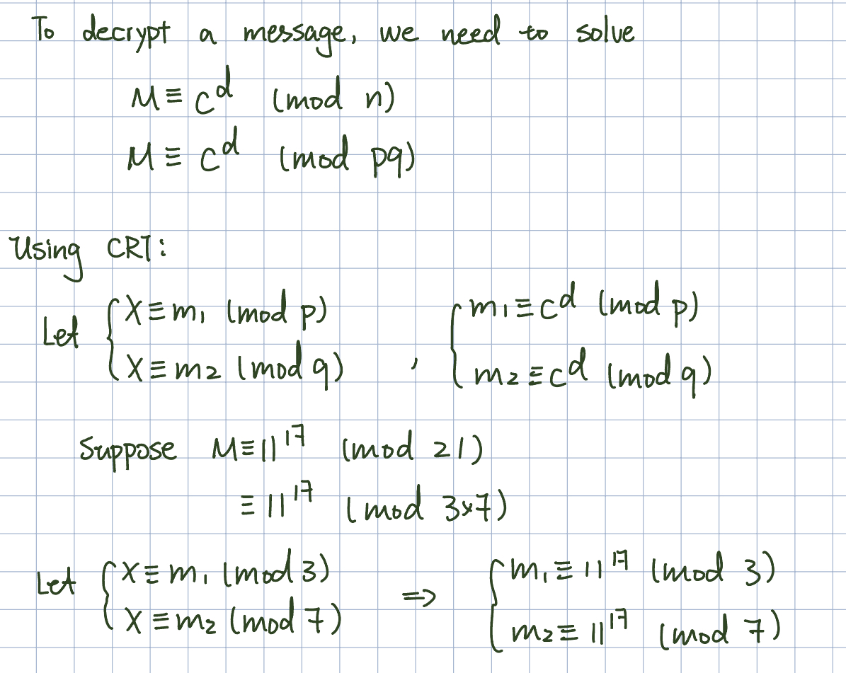
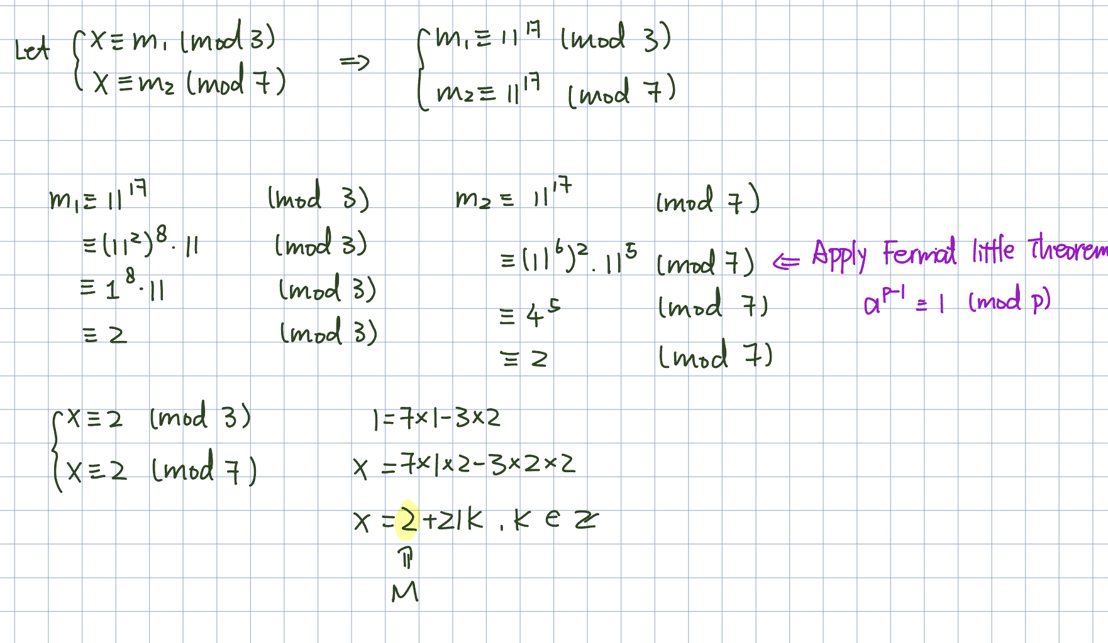
How does it accelerate the decryption in RSA
Notes:
When decrypting a message encrypted using RSA, we have to solve the modulo of the given ciphertext raised to a specific power. Traditional decryption methods, such as successive squaring, can be lengthy and redundant, particularly for complex large m. So we can apply CRT to improve accelerate the process. In RSA encryption, the modulus m is the product of two large prime numbers, p and q. Breaking down m into its prime factors allows us to solve the modulo operations separately for each prime factors. The Chinese Remainder Theorem offers a powerful tool for enhancing RSA decryption efficiency by breaking down the computation into smaller, more manageable tasks.

Slide 23
Thank you for listening!

